Slide 1
Azure Defender for IoT
100.4 Overview for Reporting & Attack Vectoring

Slide 2
Overview for Reporting and Attack Vector Deliverables
René Delbé GBB MS Germany

Slide 3
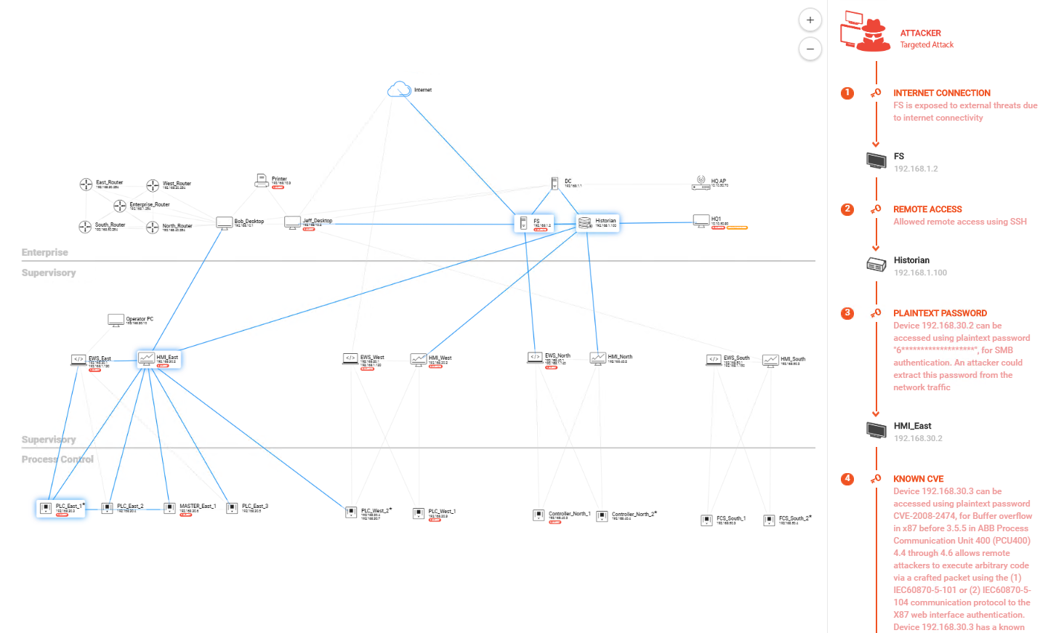

Reporting and Attack Vector Deliverables
What is it?
DM: Data Mining is the place where all relevant collected information is stored, it basically reflects the baseline
AV: Attack Vector Simulation offers the feature to visualize how devices can be compromised (“Simulated penetration test")
When to use it?
Review the collected data
Create custom reports
Simulate attack vectors
Benefits
Rich and custom reports improve productivity
Visualize collected traffic information
Identify security gaps in the network and improve the overall security status

Slide 4
Thank you

